Slide 1
LaTeX Made Simple
By Saad Zubairi,
for SE Fall 2021; Instructor: Dr. Umair Azfar

Slide 2
Introduction
LaTeX is a high-quality typesetting system; it includes features designed for the production of technical and scientific documentation. LaTeX is the de facto standard for the communication and publication of scientific documents.
The Software I made makes it simple for users to generate PDFs in LaTeX without learning the syntax of LaTeX at all.

Slide 3
Preamble
First Screen

Slide 4
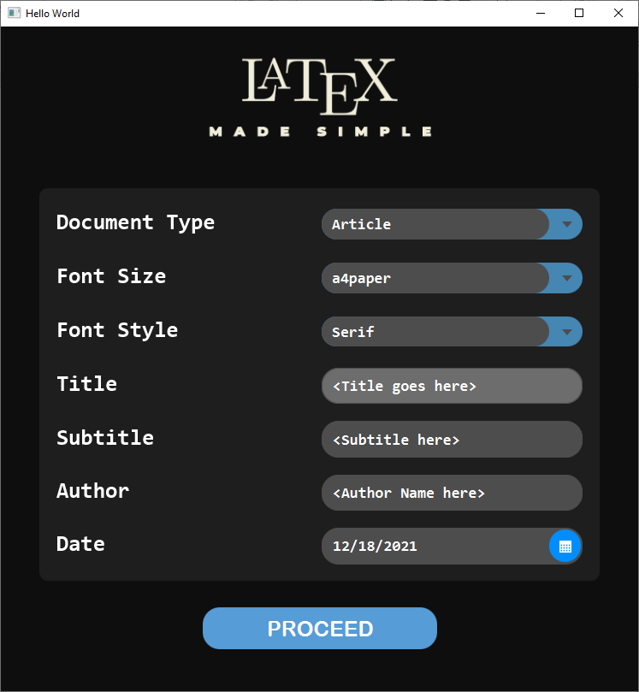
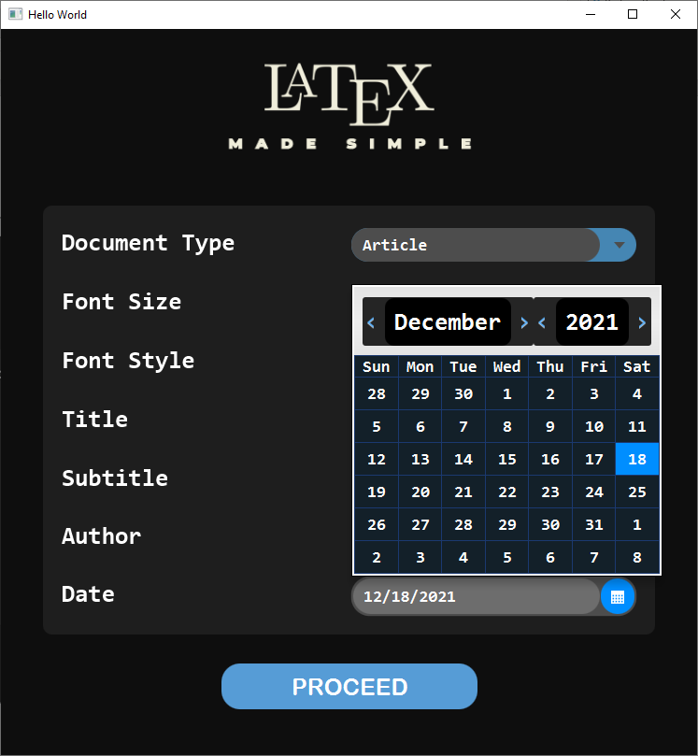
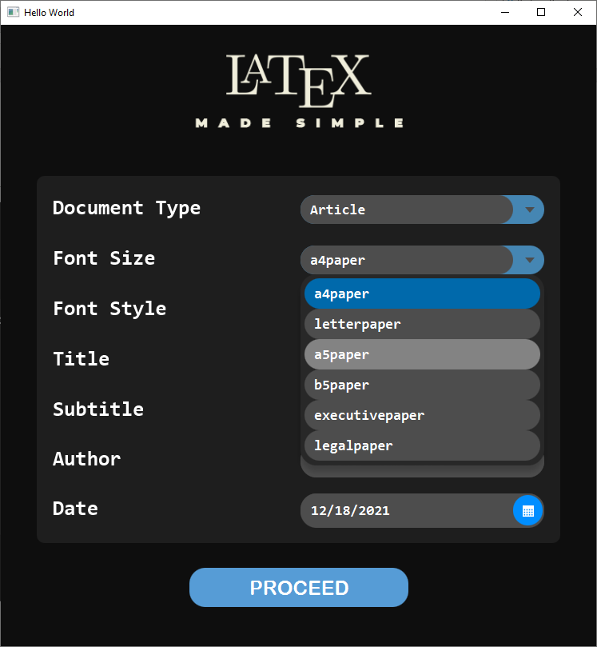

Slide 5
The Editor Screen
Filled with rich tools

Slide 6
Features:
Text Addition with sections and subsections options, which also includes adding a numbered list as well as file paths and directories in monospace in the middle of the text.
A zoomable Preview Pane for a rough idea what the final generated pdf will look like.
An Undo Button.
A Separate list addition menu for adding file paths and directories with vertical spacing.
A menu to add code as a listed or non listed item with and without pre-text.

Slide 7
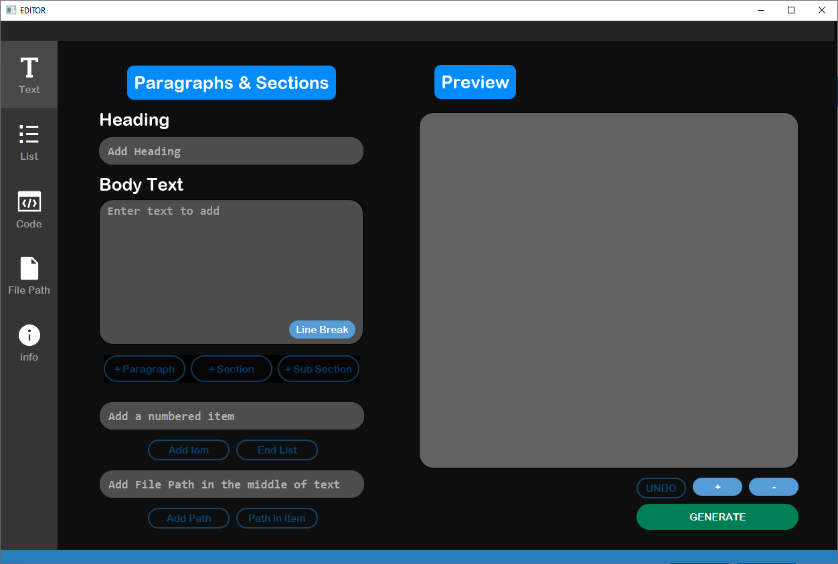
Text Addition
Menu

Slide 8
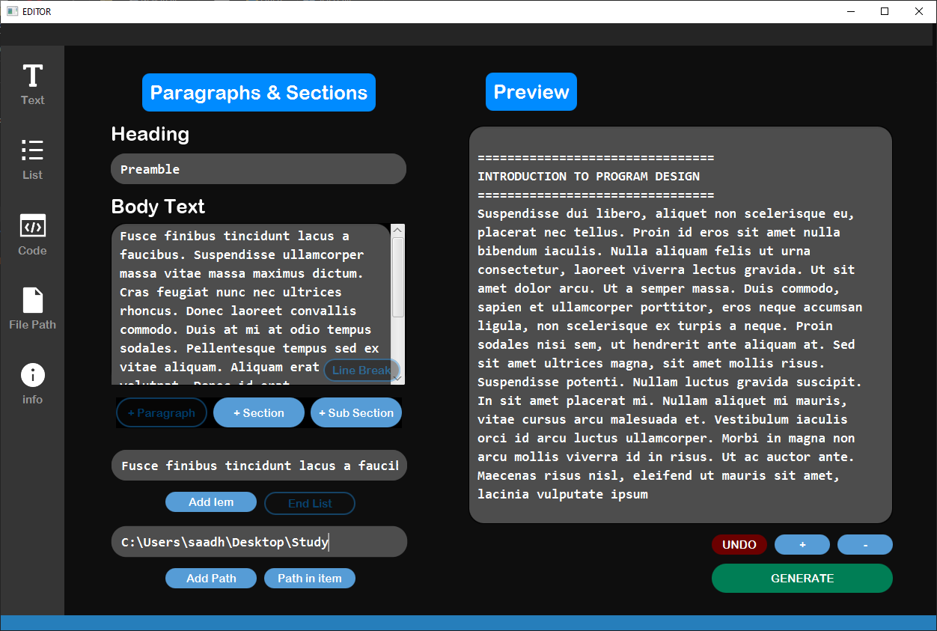
Text Addition
Menu
in all its glory

Slide 9
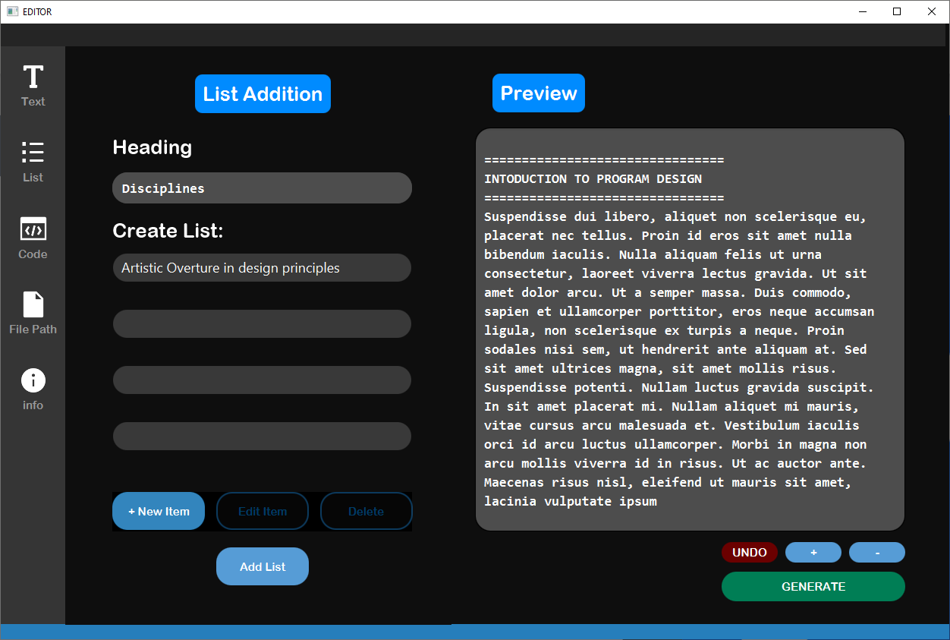
List
Addition
Menu

Slide 10
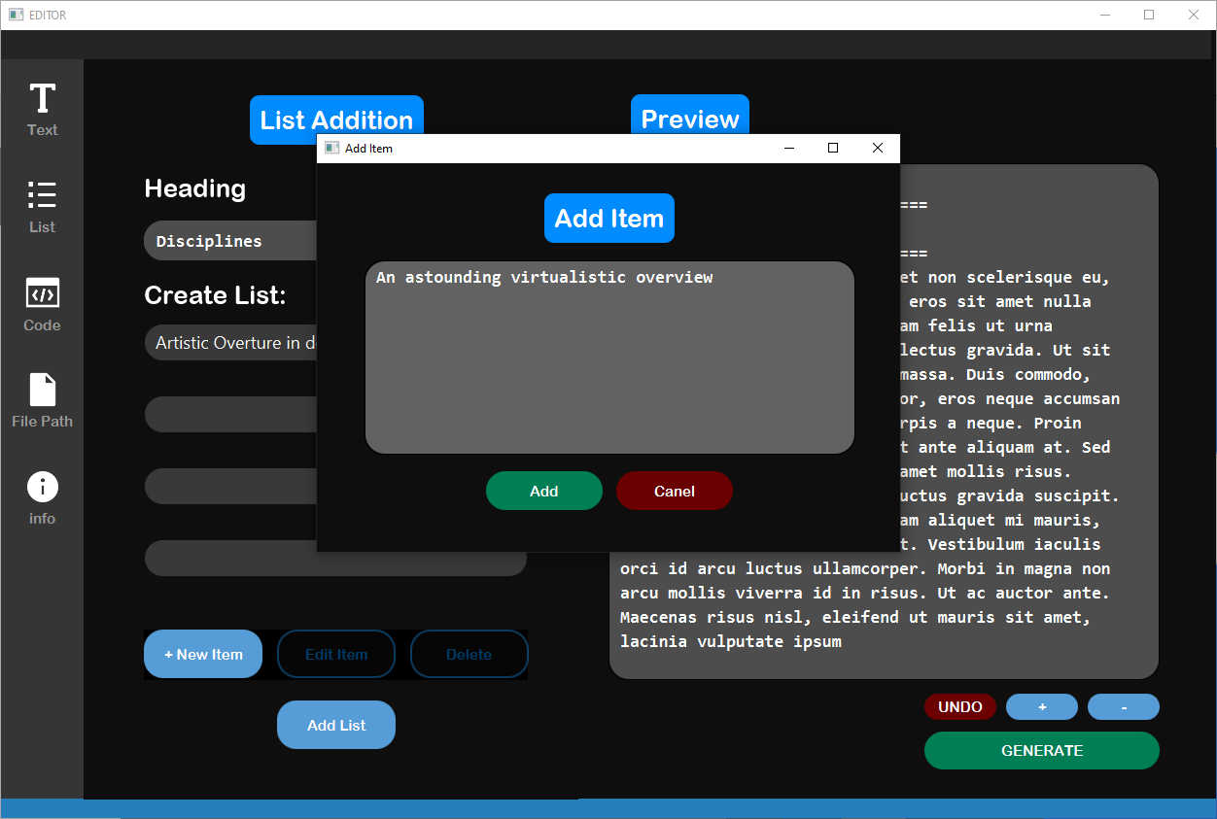
List
Addition
Menu
(With addition of an item
to the list)

Slide 11
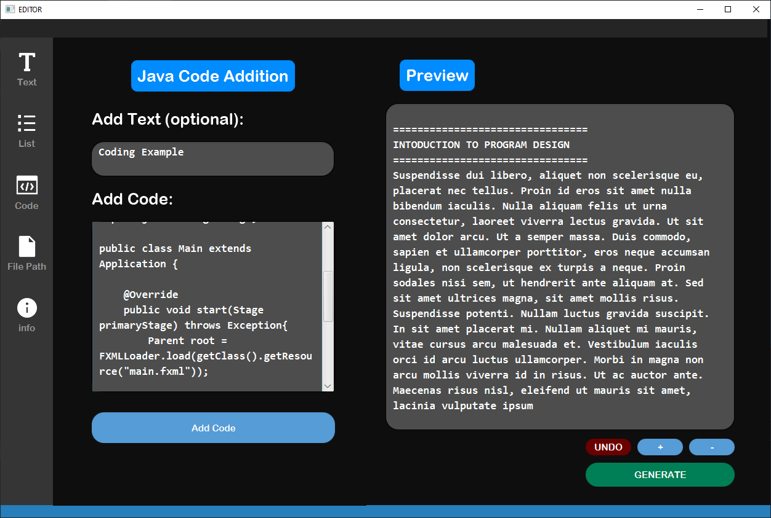
Code
Addition
Menu

Slide 12
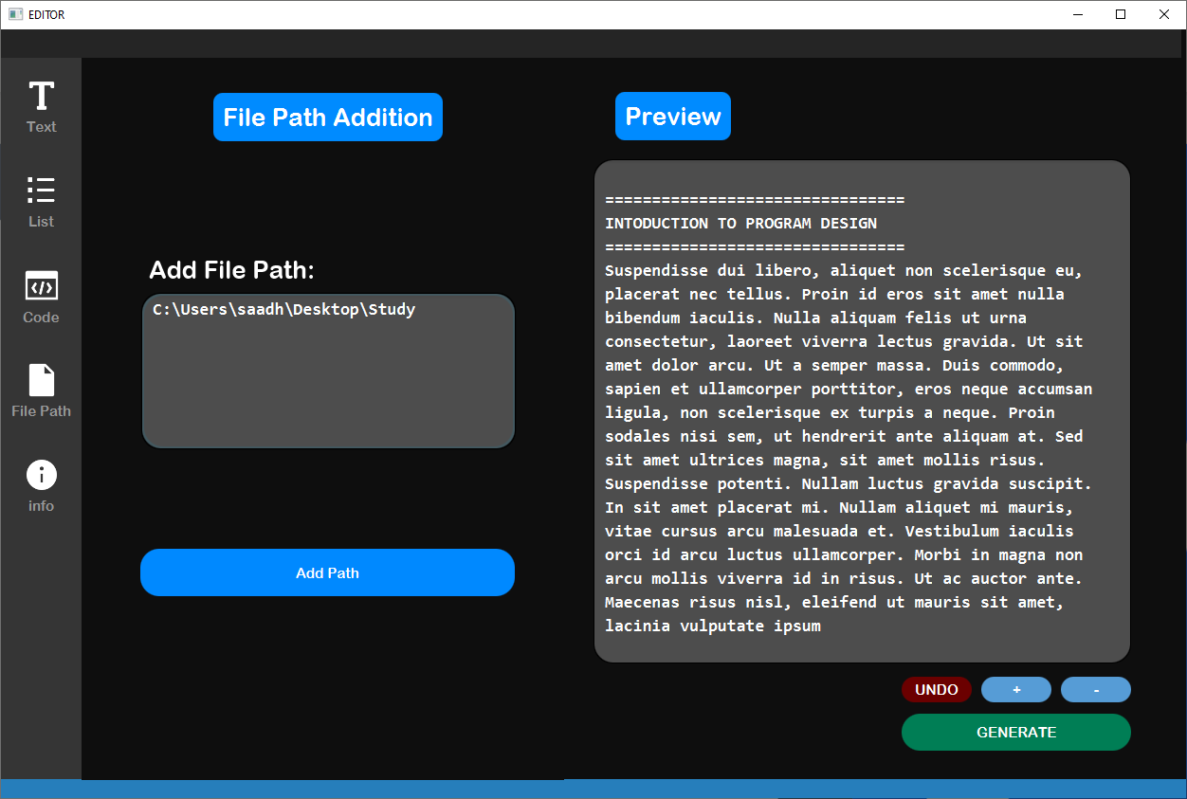
File Path
Addition
Menu

Slide 13
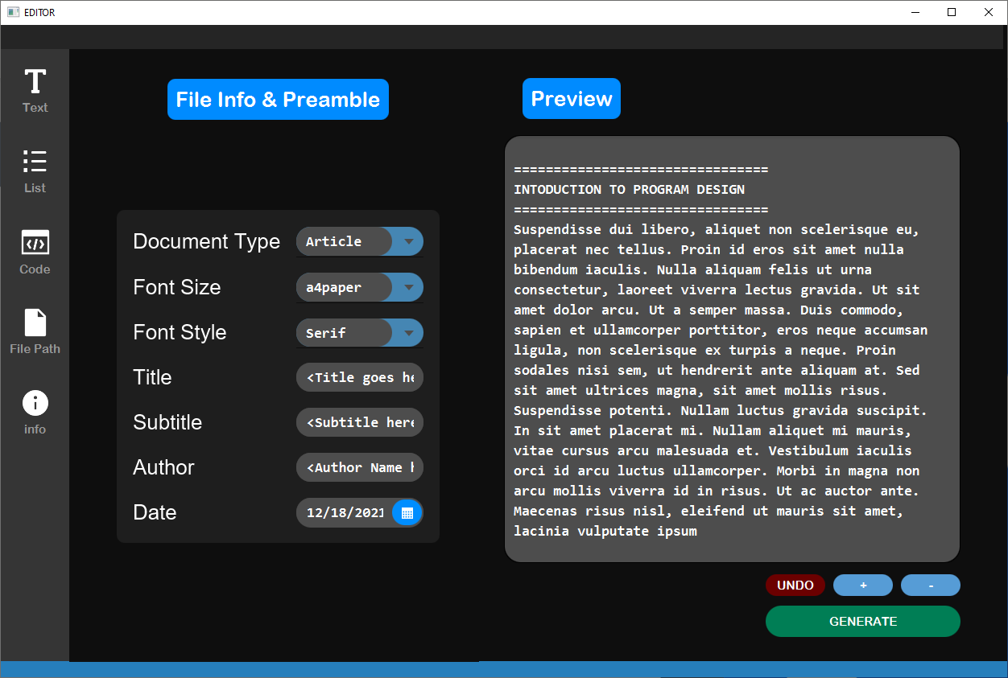
Info and Preamble
Addition and Editing
Menu

Slide 14
Generated LaTex Code Scree
The Final Screen

Slide 15
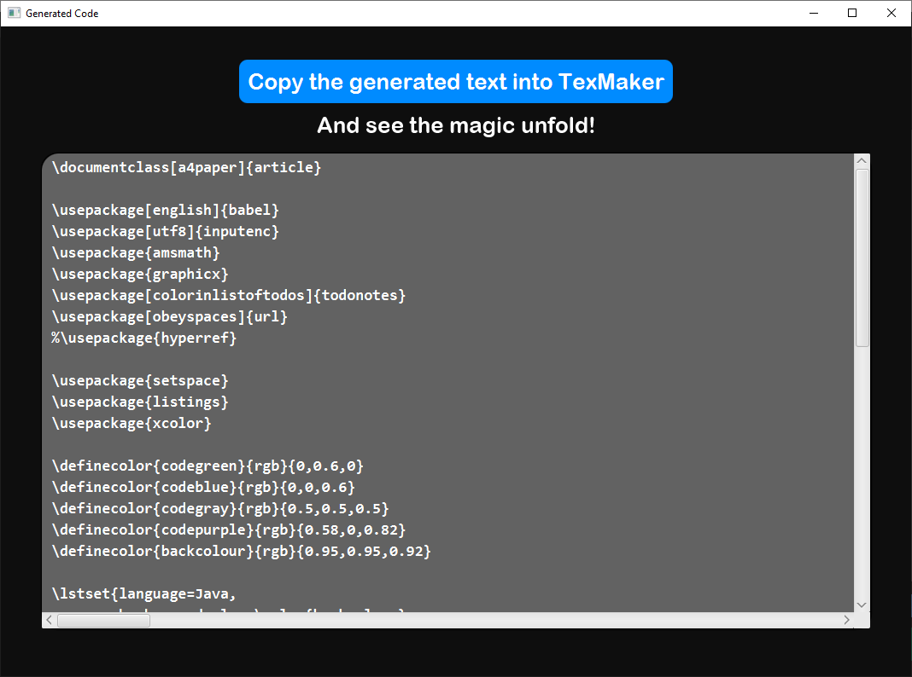

Slide 16
Thank you

